Slide 1
OpenWrt – Part 2
Includes:
SSH into HG556a reveals it is actually version B
Install the OpenWrt Version B binary image
Turn on wifi
Wifi disappears

Slide 2
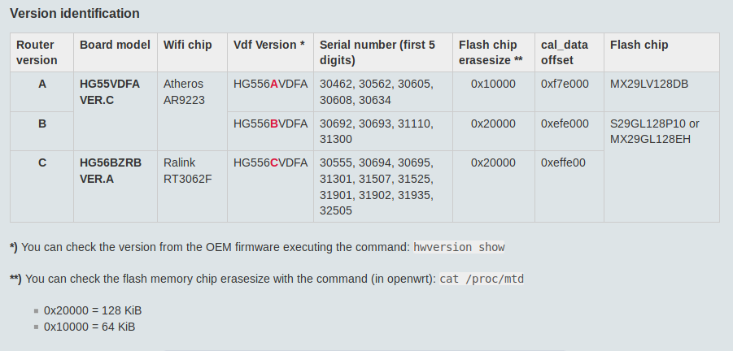
Huawei HG556a Version A ?
According to the OpenWrt documentation at
https://openwrt.org/toh/huawei/hg556a
If HG556a is Version A then it has 0x10000 = 64KB of “erasesize”, and Version B has 0x20000 = 128KB.

Slide 3
Huawei HG556a Version A ?
SSH..
0x20000 = 128KB of erasesize.
Implies: Version B.

Slide 4
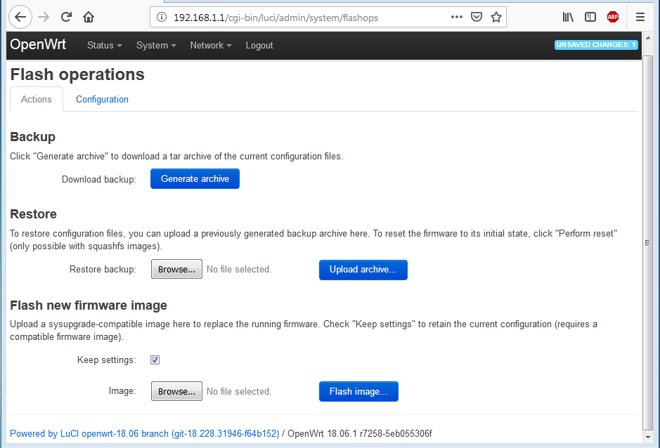
Upgrade: Huawei HG556a to Version B
Upgrade to Version B. Could try OpenWrt utility...

Slide 5

Upgrade: Huawei HG556a to Version B
Opted to...
Power on HG556a with restart button held down for +12 seconds.
Laptop at static address of 192.168.1.2 connected to HG556a ethernet port.
Firefox polls 192.168.1.1 until HG556a finishes power-on testing and displays Huawei “Update Software” screen.
Browse to select Version B file...

Slide 6
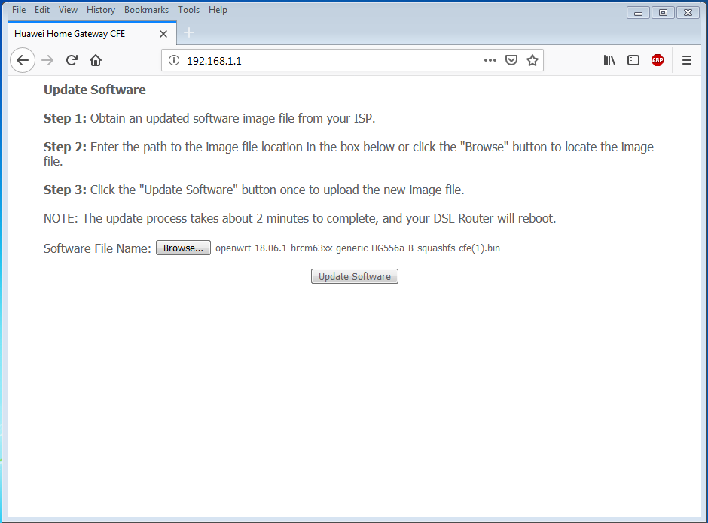
Upgrade: Huawei HG556a to Version B
...
Version B binary image.

Slide 7
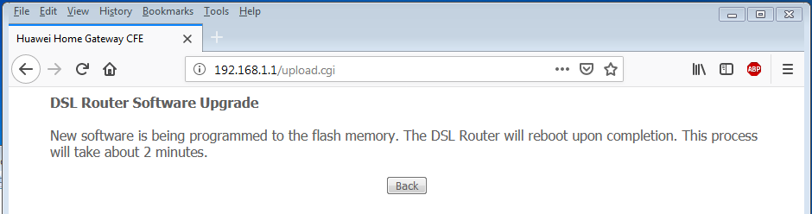
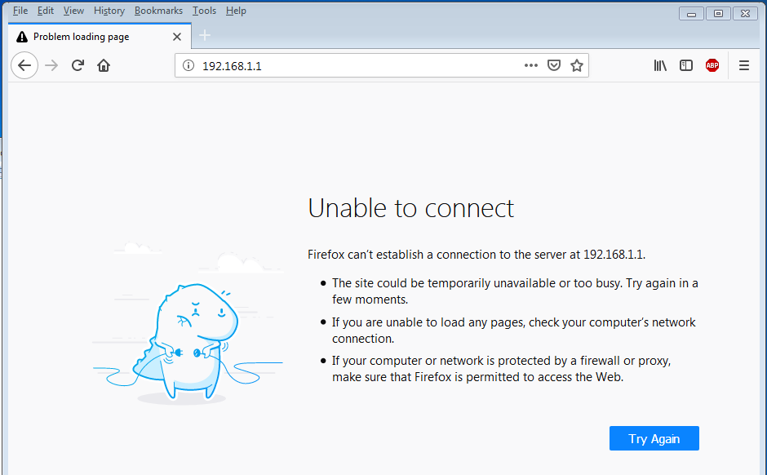
Upgrade: Huawei HG556a to Version B
After 1 minute upgrade complete, HG556a reboots, lose connection...

Slide 8
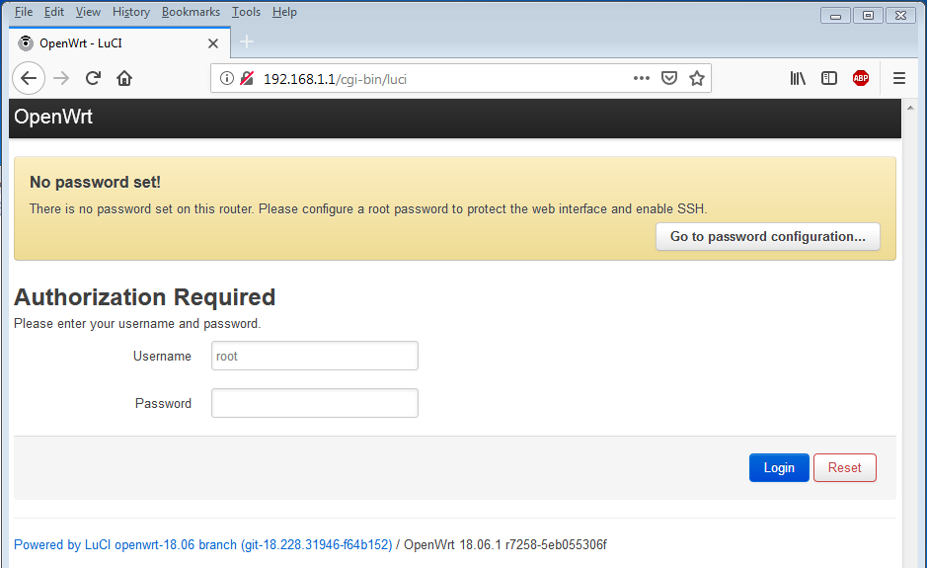
Update: Huawei HG556a to Version B
Connect to new Version B software...

Slide 9
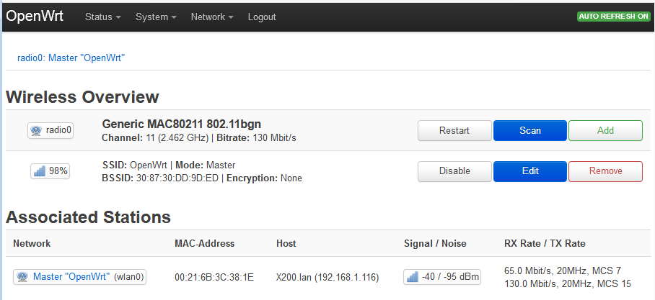
Huawei HG556a - gTurn on Wifi
Select Network, then Wireless
Clicked to enable wifi.
Ian’s laptop has made connection to SSID “OpenWrt”, with no password. Allocated 192.168.1.116

Slide 10
Huawei HG556a
...And then it went pear shaped...
Upon turning off and back on...
The wireless disappeared and was never seen again.
Possibly the “cal_data” partition in Memory Technology Device (mtd) is corrupted.
Cal_data holds the wireless chip configuration data.
This forum posting covers the issues https://forum.openwrt.org/t/no-wifi-in-18-06-with-hg556a/19510/2 and links to this Spanish forum http://www.ipv6labs.es/2015/02/26/mi-router-huawei-hg556a-no-reconoce-el-wifi-tras-cargar-varios-firmwares/
Comments on forum still in progress as of 22 Jan 2019. Troubleshooter: Didac P. Cuéllar

Slide 11
Huawei HG556a
...The End of Hauwei ...for now.
OR... Carry on and show summary of OpenWrt packages...

Slide 12
OpenWrt Packages Summary
administration |  | 9
administration | openwisp | 4
administration | zabbix | 8
base system |  | 54
boot loaders |  | 1
development |  | 25
development | libraries | 2
firmware |  | 113
firmware | wireless drivers | 4
fonts | dejavu | 22

Slide 13
OpenWrt Packages Summary
kernel modules |  | 728
kernel modules | cryptographic api modules | 3
kernel modules | firewall | 23
kernel modules | hardware monitoring support | 1
kernel modules | i2c support | 1
kernel modules | led modules | 1
kernel modules | libraries | 1
kernel modules | network devices | 24
kernel modules | network support | 12
kernel modules | other modules | 23
kernel modules | proprietary bcm43xx wifi driver | 5
kernel modules | spi support | 1
kernel modules | usb support | 2
kernel modules | voice over ip | 6
kernel modules | w1 support | 1
kernel modules | wireless drivers | 82

Slide 14
OpenWrt Packages Summary
languages |  | 1
languages | erlang | 12
languages | java | 1
languages | lua | 47
languages | node.js | 9
languages | perl | 150
languages | php | 53
languages | python | 235
languages | ruby | 65

Slide 15
OpenWrt Packages Summary
libraries |  | 472
libraries | compression | 3
libraries | database | 6
libraries | filesystem | 5
libraries | firewall | 5
libraries | instant messaging | 1
libraries | ip addresses and names | 1
libraries | languages | 1
libraries | libelektra | 16
libraries | linux atm tools | 1
libraries | lua | 1
libraries | networking | 9
libraries | ruby | 1
libraries | sound | 1
libraries | ssl | 4
libraries | telephony | 193

Slide 16
OpenWrt Packages Summary
luci | applications | 69
luci | collections | 5
luci | freifunk | 10
luci | libraries | 11
luci | modules | 6
luci | protocols | 10
luci | themes | 4
mail |  | 26
multimedia |  | 146
multimedia | streaming | 1

Slide 17
OpenWrt Packages Summary
network |  | 297
network | bittorrent | 12
network | captive portals | 8
network | dial in up | 2
network | download manager | 3
network | file transfer | 12
network | filesystem | 12
network | firewall | 64
network | firewall tunnel | 2
network | freeradius version 3 | 30
network | instant messaging | 63
network | ip addresses and names | 66
network | linux atm tools | 26
network | nmap suite | 6
network | ntrip | 3
network | olsr.org network framework | 4

Slide 18
OpenWrt Packages Summary
network | open vswitch | 20
network | printing | 1
network | routing and redirection | 79
network | ssh | 10
network | tcprelay | 8
network | telephony | 878
network | telephony lantiq | 2
network | thc ipv6 attack and analyzing toolkit | 52
network | time synchronization | 8
network | version control systems | 8
network | vpn | 108
network | web servers proxies | 66
network | wireless | 11
network | wwan | 5

Slide 19
OpenWrt Packages Summary
sound |  | 37
utilities |  | 660
utilities | boot loaders | 4
utilities | compression | 15
utilities | database | 51
utilities | disc | 17
utilities | editors | 9
utilities | encryption | 11
utilities | filesystem | 34
utilities | image manipulation | 2
utilities | libelektra | 1
utilities | microcontroller programming | 3
utilities | rtklib suite | 5
utilities | shells | 6
utilities | telephony | 5
utilities | terminal | 16
utilities | virtualization | 6
utilities | zoneinfo | 12
xorg | font utils | 1

Slide 20
OpenWrt Packages Summary
Total Packages (January 2019): 5498
https://openwrt.org/packages/table/start
Good code examples...
https://unix.stackexchange.com/questions/157097/how-to-know-disk-space-occupied-by-packages-in-openwrt
...

